Slide 1

Orientation to “DEVELOPERS”
in Integrated Engineering Process
Presented by: PALM [Earlier: Process Team]
Copyright © 2021 Cybage Software Pvt. Ltd. All Rights Reserved. Cybage Confidential.
www.cybage.com
1

Slide 2

Agenda
§ Introduction to PALM
§ Introduction to Quality Management System
§ Quick Glance at Q@Core
§ Project Lifecycles
§ Overview of ALM-DevOps Practices & Integration
§ Accountability as a developer
§ Development Environment setup
§ Tool Setup
§ Development Activities
§ Complement to Project Management
§ Contribute Horizontally!
§ Q&A
Copyright © 2021 Cybage Software Pvt. Ltd. All Rights Reserved. Cybage Confidential.
www.cybage.com
2

Slide 3

Introduction to PALM
§ Productivity Assurance & Lifecycle Management (PALM), formerly known as
Process Team
§ Aims to build the culture of Process Oriented & data driven implementation
§ Defines the right set of practices in the organization, with help of Practitioners
§ Emphasis on Tools driven practices rather than manual or documented way
§ Brings the flexibility required in context of project(s); enables adopting &
integrating Customer specific processes
§ Interaction between PALM & Delivery team starts right at the project start.
Copyright © 2021 Cybage Software Pvt. Ltd. All Rights Reserved. Cybage Confidential.
www.cybage.com
3

Slide 4
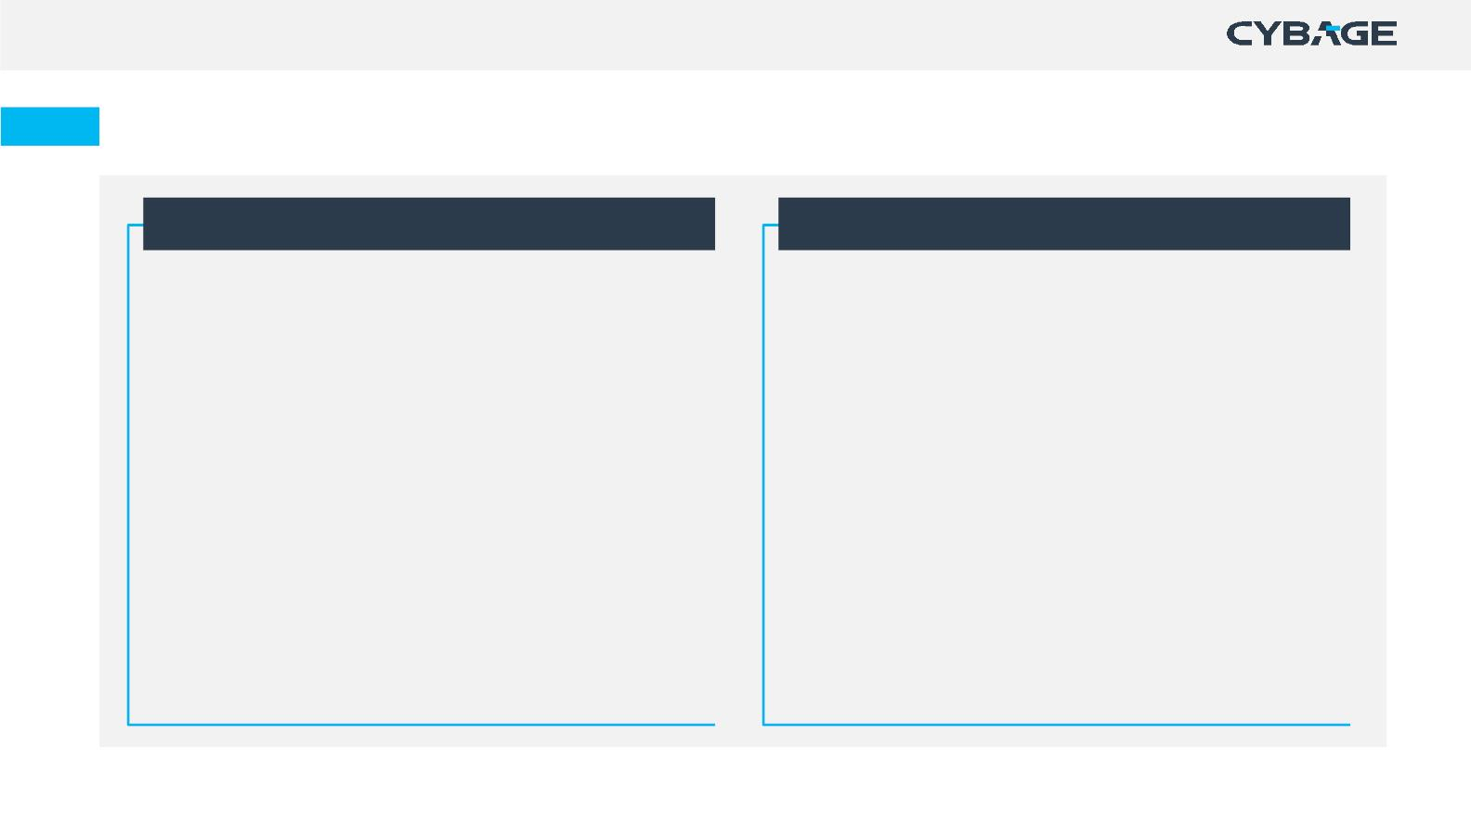
PALM – Functioning
New Customer Care [NCC]
Process Definition & Auditing Team
§ Process setup for New Customer projects
§ Conduct session on Best Practices and required tools
§ ALM tool setup and customization & consulting
§ Facilitates, Reviews and Suggests
§ Process Definition & Maintenance
§ Impart Process & Tool Trainings
§ Provides Process and ALM tool consulting
§ Facilitate Implementation of ALM / Tool driven Practices
§ Conduct Audits on defined periodicity
§ Report Project health to Sr. Management & Executive
Management
§ Report results to Sr. Management
§ Stabilize Process & Tool usage in first 3-4 months
§ Transitions the Project to Auditing Team.
§ Involved in Process automation
§ Facilitate other Continuous Improvement Initiatives.
Copyright © 2021 Cybage Software Pvt. Ltd. All Rights Reserved. Cybage Confidential.
www.cybage.com

Slide 5
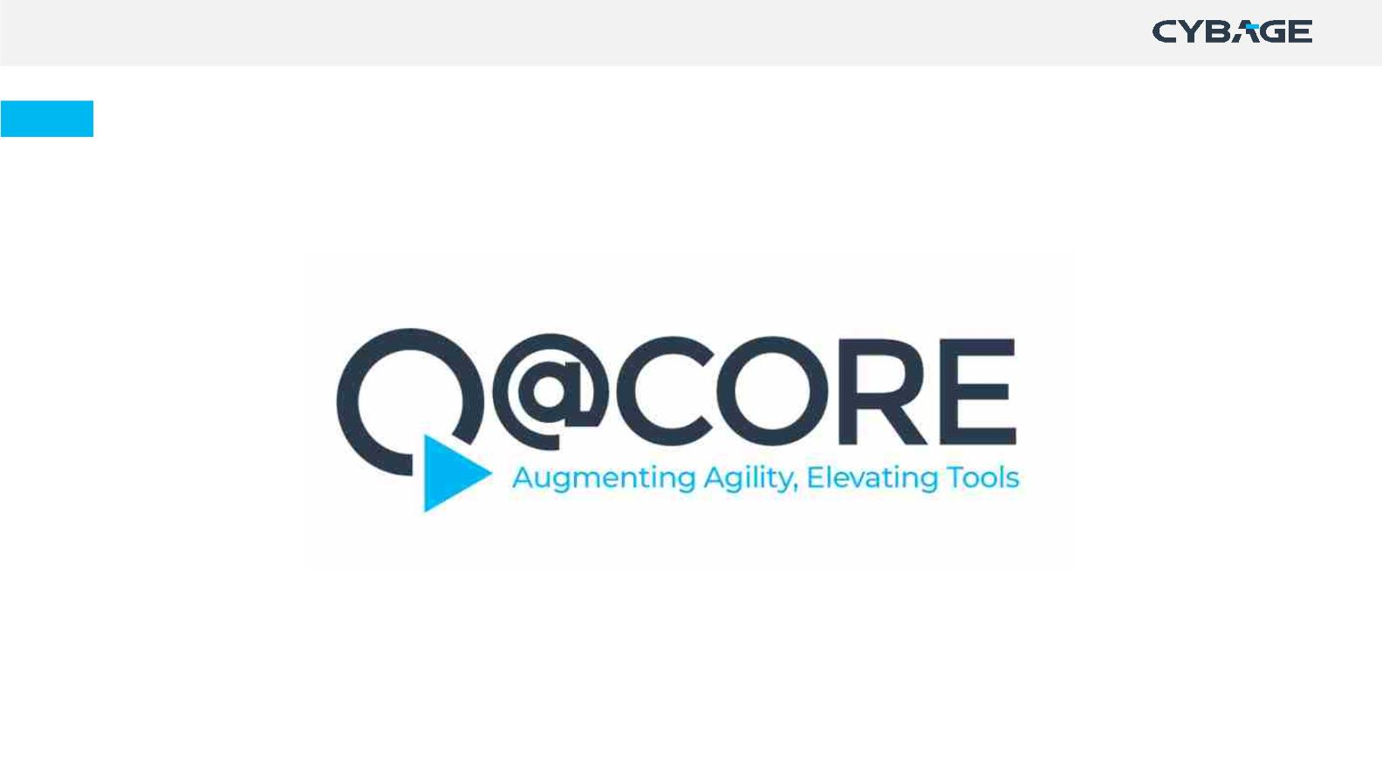
Quality Management System at Cybage
Copyright © 2021 Cybage Software Pvt. Ltd. All Rights Reserved. Cybage Confidential.
www.cybage.com
5

Slide 6
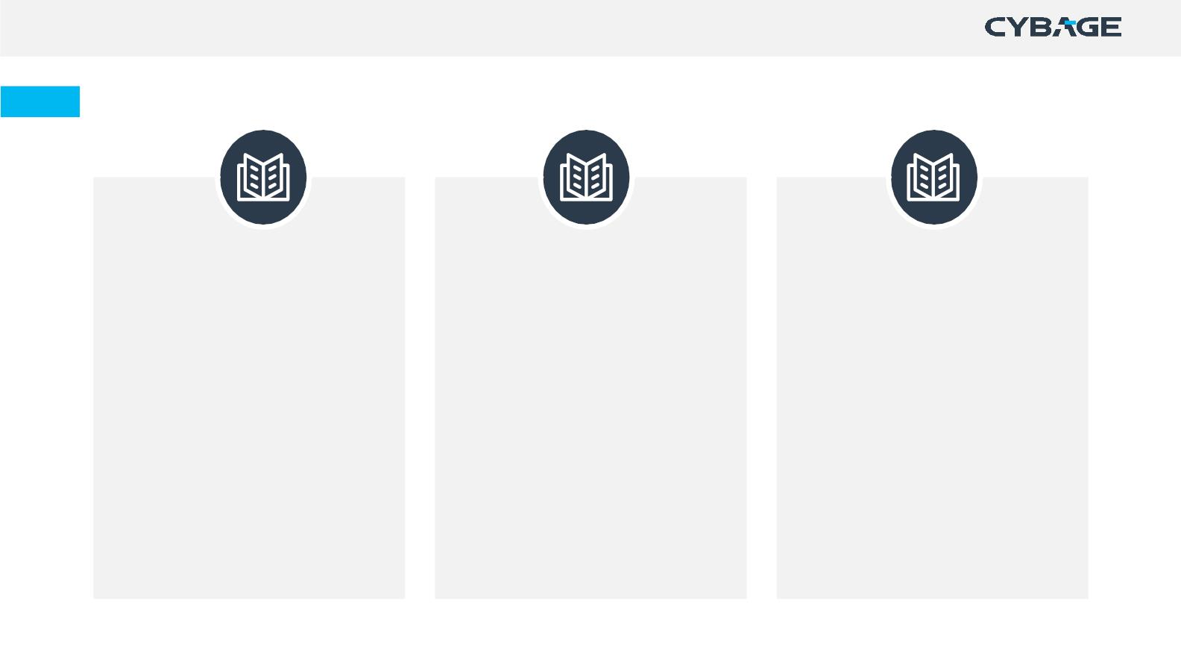
Quick Glance at Q@Core
Apex Manual
Process Manual
Departmental Manual
• Organization information
• Traditional Development
• Engineering
• Human Resource
• Administration
• Organization & Project Structure
• Lifecycles and Execution Models
• Overview of Processes
• Project Management
• Agile Development
• Scrum
• Information System
• Roles and responsibilities
• Information of enabling functions
• Kanban
• Horizontal Processes
• Support Services
• Content Services
• Business Processes
Copyright © 2021 Cybage Software Pvt. Ltd. All Rights Reserved. Cybage Confidential.
www.cybage.com
6

Slide 7
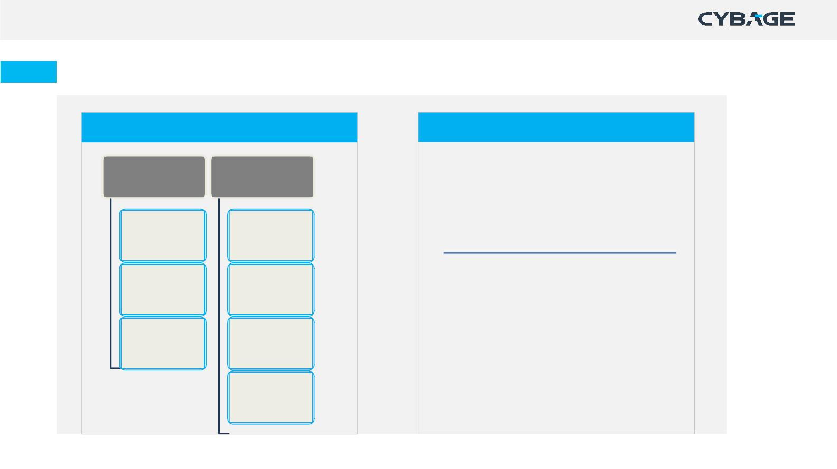
Process Manual
Traditional Development Practices
Agile Development Practices
Engineering
Project
•
Agile Methodology
Management
• Scrum @ Cybage
• Kanban @ Cybage
Development
Lifecycle
Project
Initiation
Testing
Project
•
Project Initiation Process
Lifecycle
Planning &
Monitoring
• Process for Scrum Projects
• Process for Kanban Projects
Maintenance
Lifecycle
Change
Management
Project Closure
Copyright © 2021 Cybage Software Pvt. Ltd. All Rights Reserved. Cybage Confidential.
www.cybage.com

Slide 8
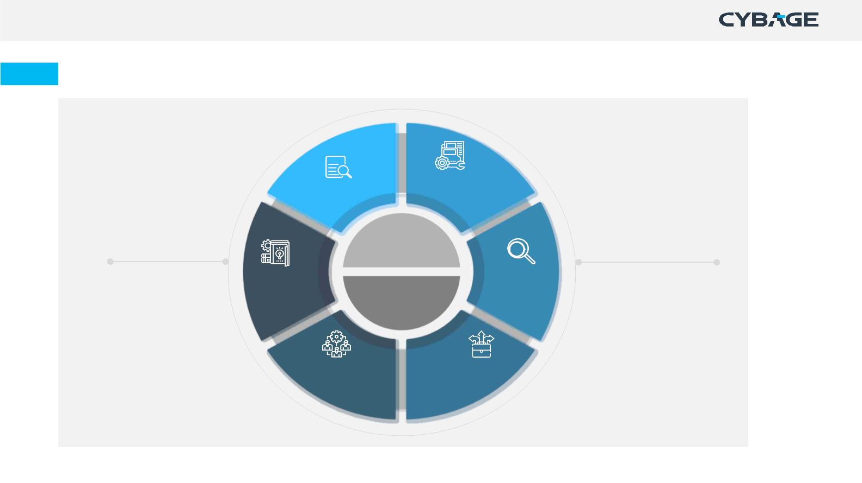
Process Manual
Horizontal Processes
Internal Audits
Configuration
Management
Engineering
QMS
Management
Knowledge
Management
Root Cause
Analysis
Continuous
Improvement
Project
Management
Resource
Management
Decision
Analysis &
Resolution
Copyright © 2021 Cybage Software Pvt. Ltd. All Rights Reserved. Cybage Confidential.
www.cybage.com
8

Slide 9

Lifecycle & Execution Methodologies
Copyright © 2021 Cybage Software Pvt. Ltd. All Rights Reserved. Cybage Confidential.
www.cybage.com
9

Slide 10
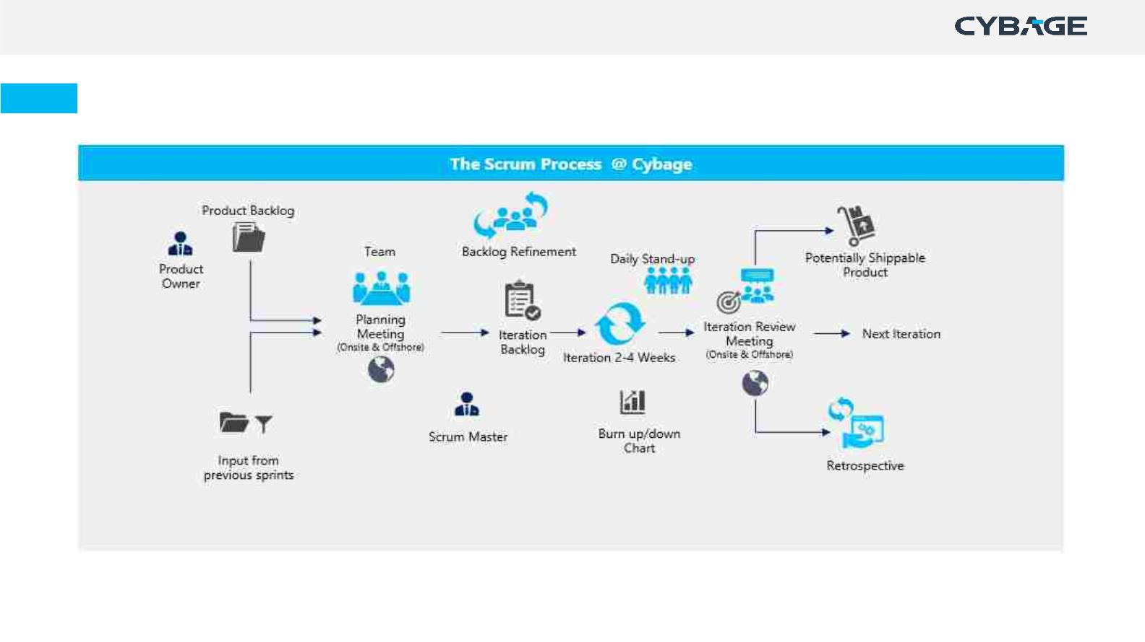
Scrum
Copyright © 2021 Cybage Software Pvt. Ltd. All Rights Reserved. Cybage Confidential.
www.cybage.com
10

Slide 11
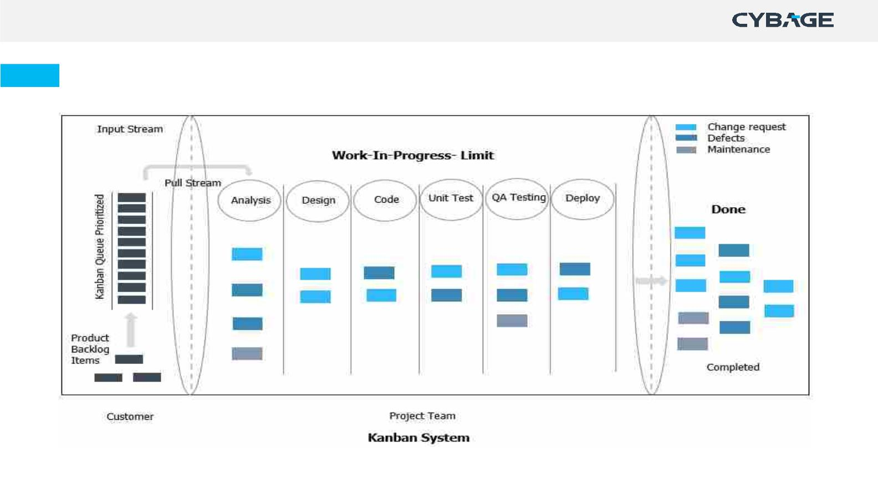
Kanban
Copyright © 2021 Cybage Software Pvt. Ltd. All Rights Reserved. Cybage Confidential.
www.cybage.com
11

Slide 12
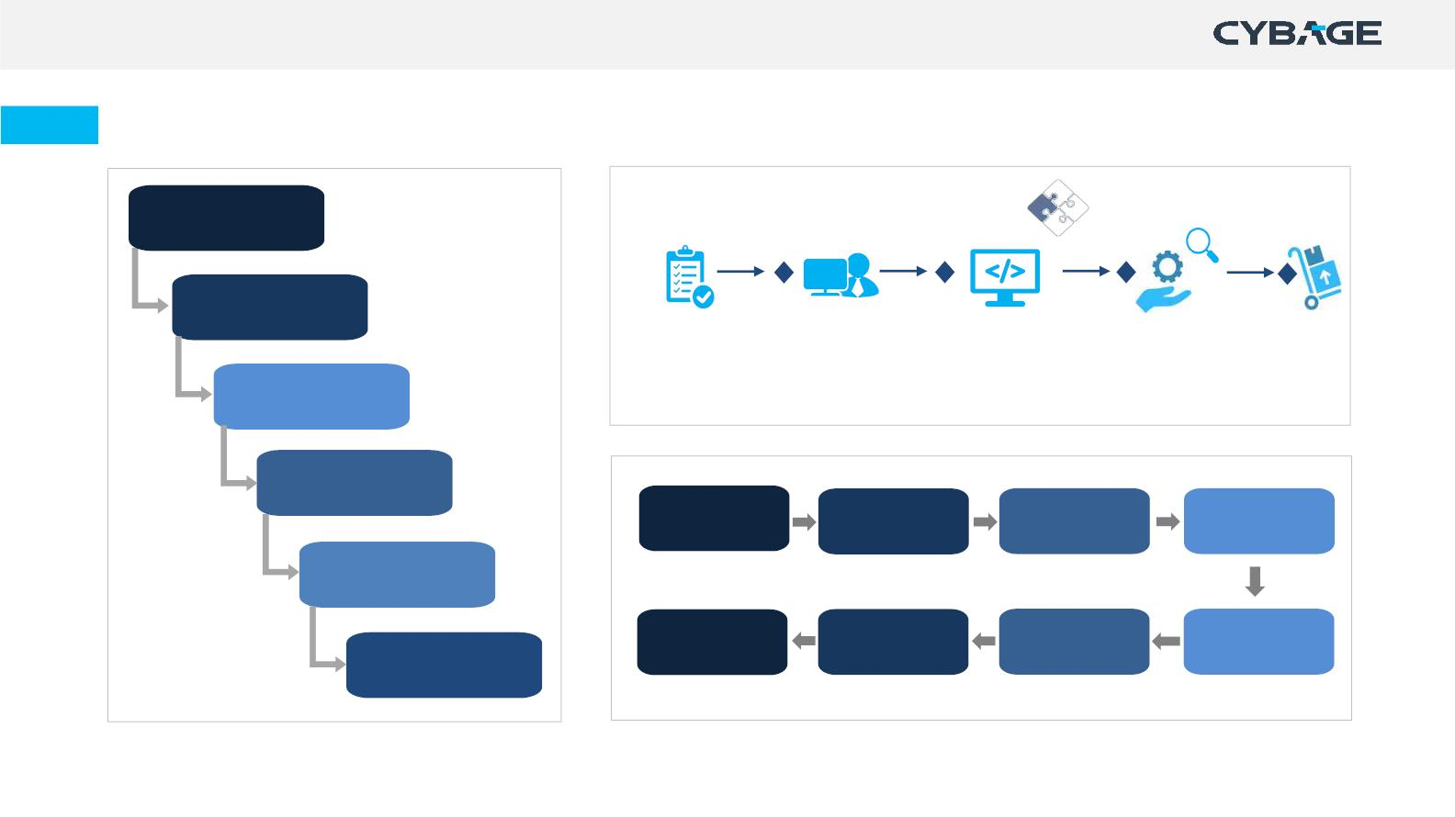
Waterfall, Maintenance & Testing Lifecycle
Requirements
Design
Build & Test
Unit Tests
Maintenance
Request
Impact
Analysis
Implementation
Deploy
Development
Testing
Requirement
Analysis
Test Planning
Test Case
Design
Testing
Deployment
Test Closure
Regression
Testing
Defect
Retesting
Test Result
Reporting
Maintenance
Copyright © 2021 Cybage Software Pvt. Ltd. All Rights Reserved. Cybage Confidential.
www.cybage.com
12

Slide 13
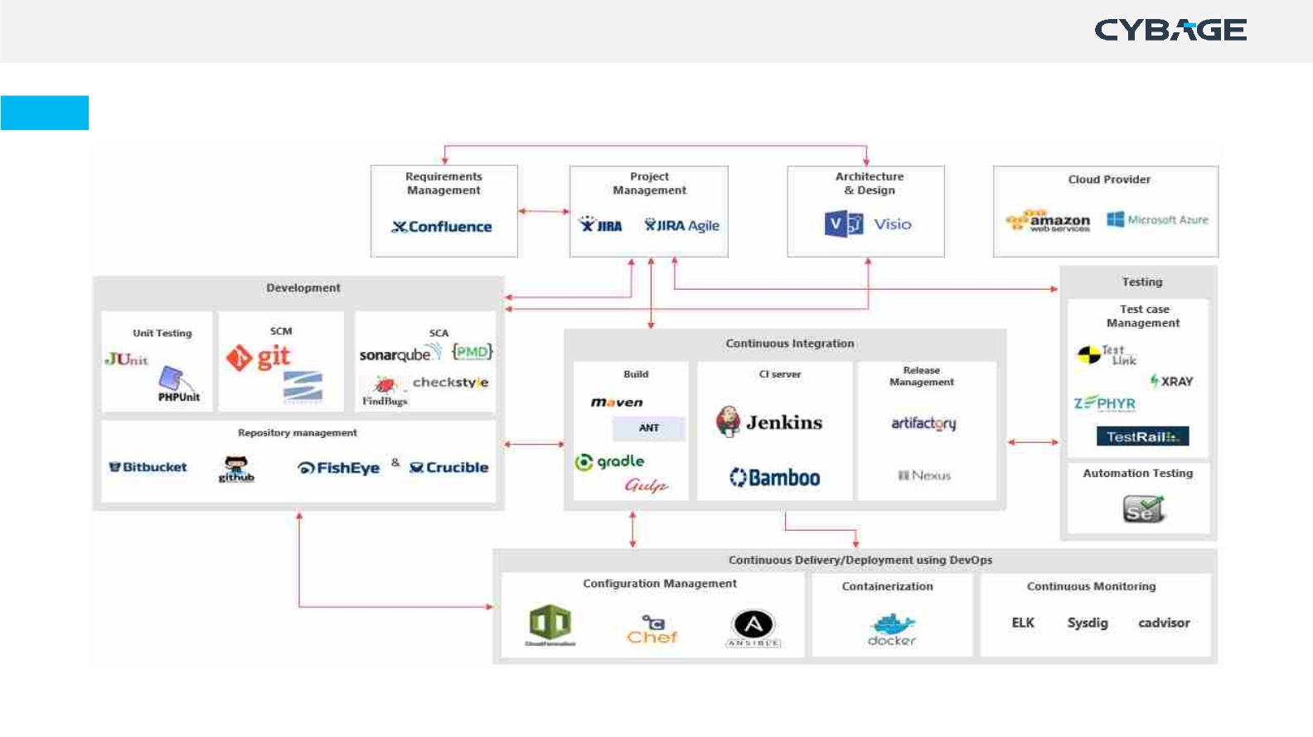
ALM-DevOps Practices & Tool Integration – Opensource & Licensed Tools
Copyright © 2021 Cybage Software Pvt. Ltd. All Rights Reserved. Cybage Confidential.
www.cybage.com
13

Slide 14
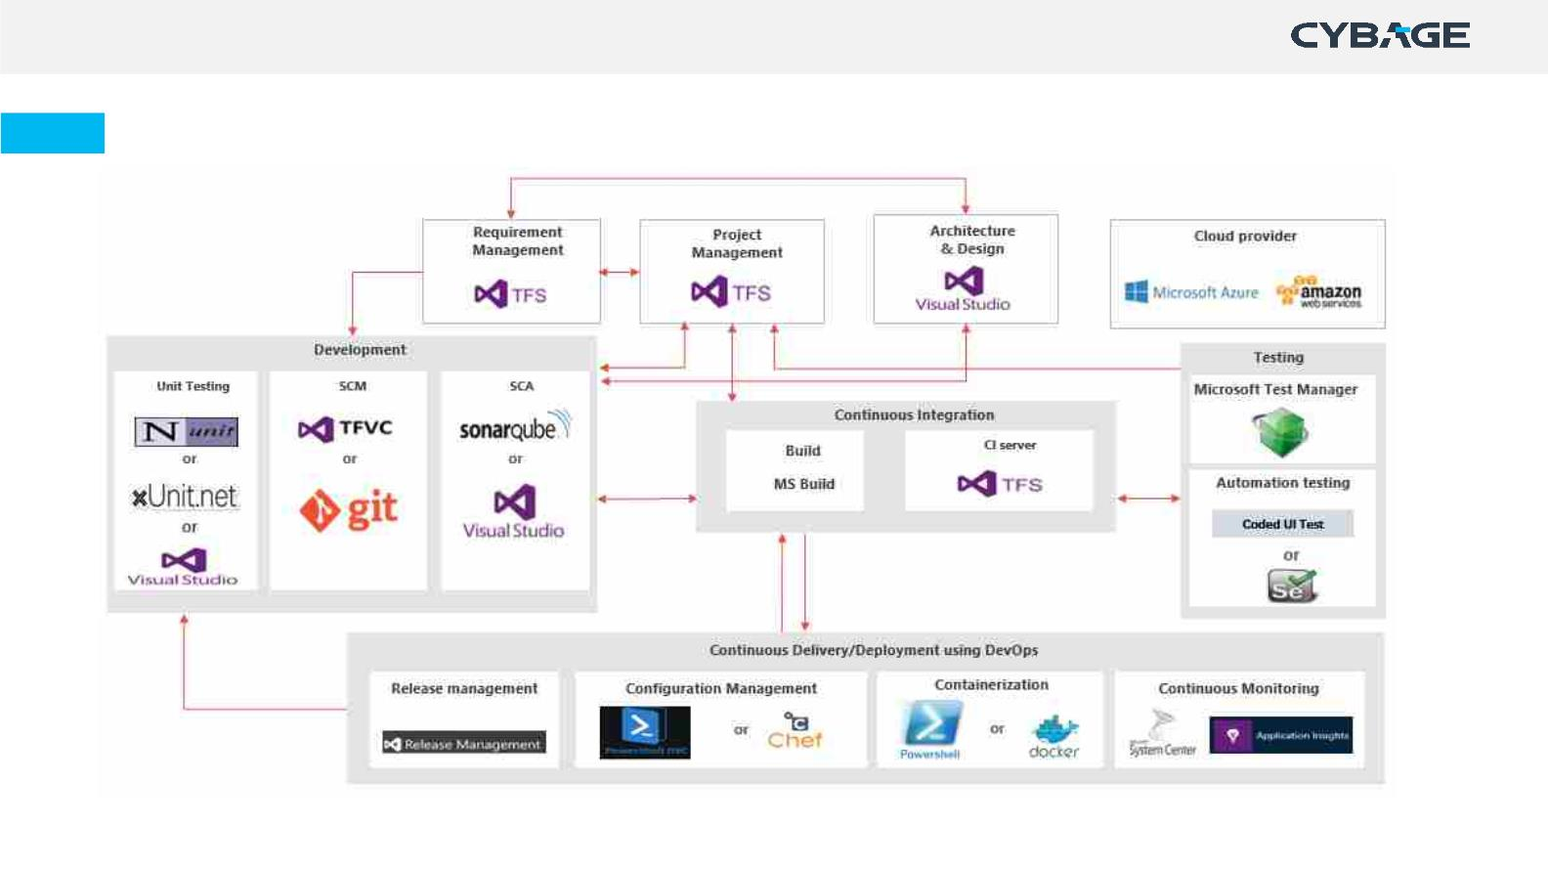
ALM-DevOps Practices & Tool Integration – Microsoft Tools
Copyright © 2021 Cybage Software Pvt. Ltd. All Rights Reserved. Cybage Confidential.
www.cybage.com
14

Slide 15
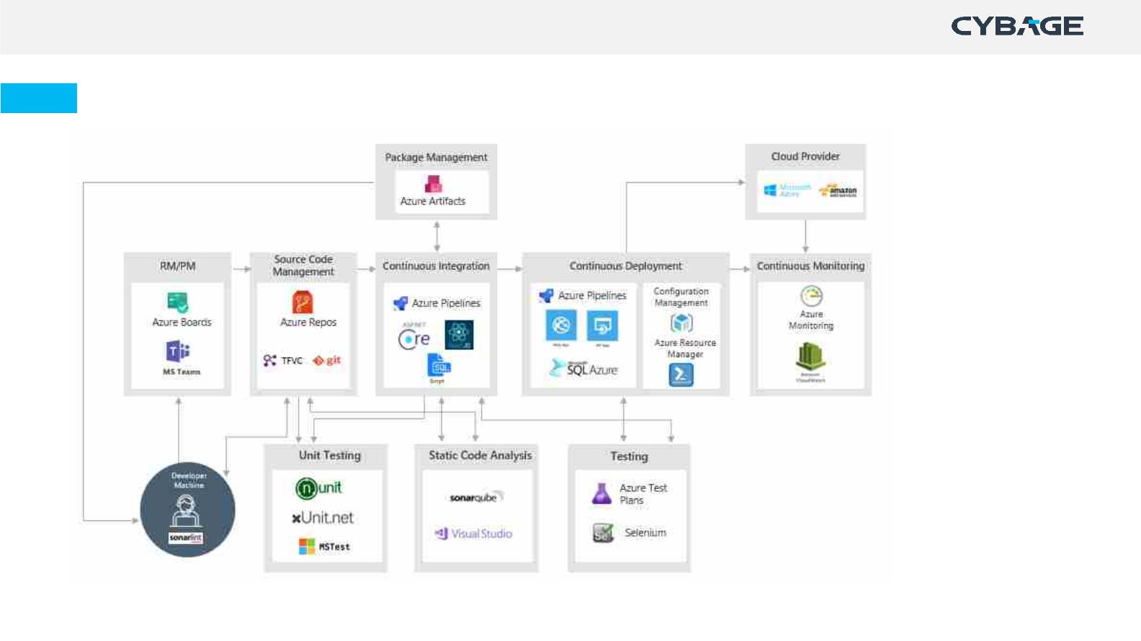
ALM-DevOps Practices & Tool Integration – Microsoft Azure
Copyright © 2021 Cybage Software Pvt. Ltd. All Rights Reserved. Cybage Confidential.
www.cybage.com
15

Slide 16

Role – DEVELOPERS
Copyright © 2021 Cybage Software Pvt. Ltd. All Rights Reserved. Cybage Confidential.
www.cybage.com
16

Slide 17
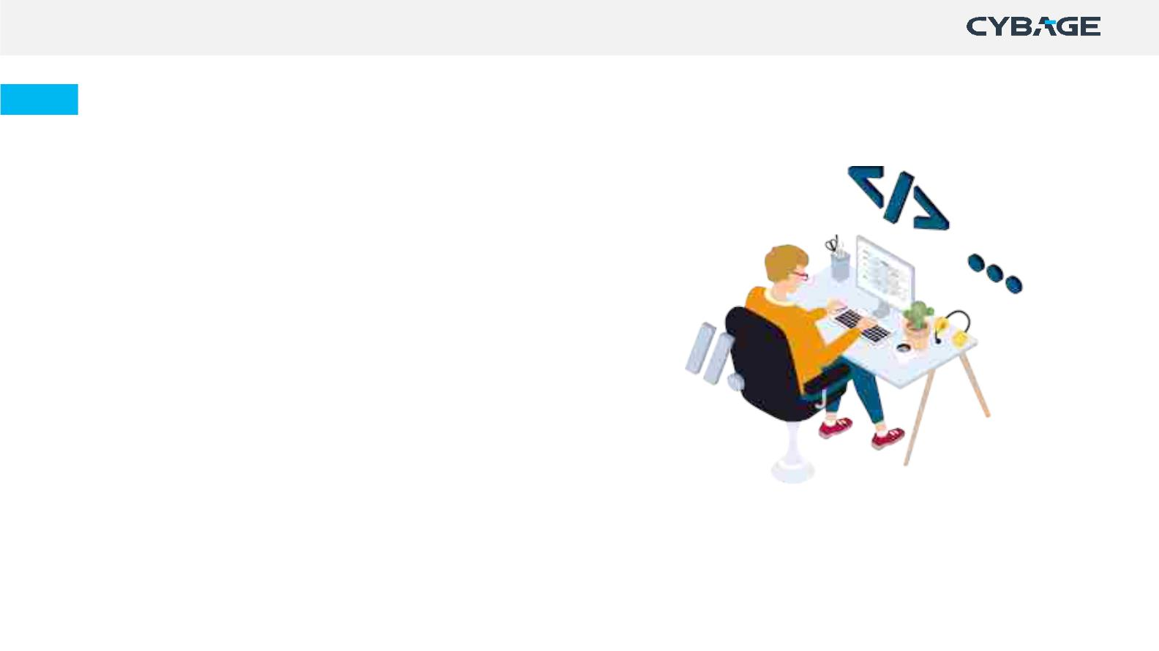
Accountability as a developer
The Developers are always accountable for:
Ø Creating a plan for the Sprint, the Sprint Backlog
Ø Instilling quality by adhering to a Definition of
Done;
Ø Adapting their plan each day toward the Sprint
Goal; and,
Ø Holding each other accountable as professionals.
Copyright © 2021 Cybage Software Pvt. Ltd. All Rights Reserved. Cybage Confidential.
www.cybage.com
17

Slide 18
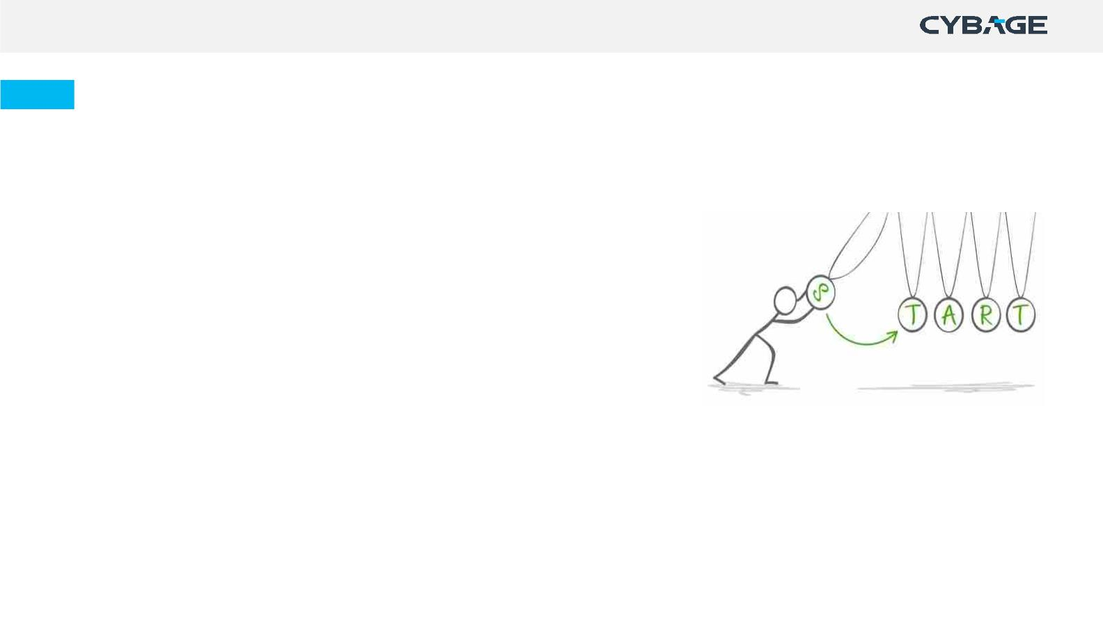
Project Kickoff
Ø Participate in project kickoff
Ø Get information of environment & tools identified for the project
Ø Know about in-scope, out-scope activities & requirements
Ø Know the Methodology, Deliverables & Timelines
Ø Understand assumptions, dependencies, constraints & risks in the
project
Ø Get familiar with - Team hierarchy, Reporting requirements,
Escalation Protocols
Ø Receive Training / KT / Ramp up of project from Client and Other
relevant stakeholders like BA, Architect, Other vendors (if
involved).
Copyright © 2021 Cybage Software Pvt. Ltd. All Rights Reserved. Cybage Confidential.
www.cybage.com
18

Slide 19
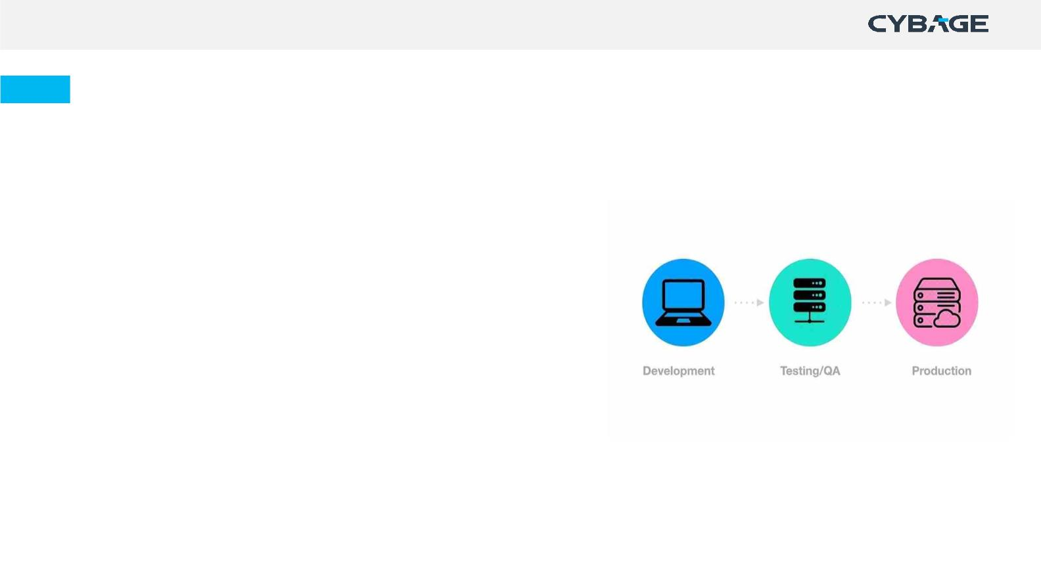
Development Environment setup
Development environment is a set of processes and tools for developing an application or program.
Set-up requirements:
Ø Knowledge of customer & business requirements
Ø Operating system, Hardware & Devices
Ø IDE Configuration like visual studio, eclipse etc.
Ø Setting up the extension(s) and plugin(s) like SonarLint,
NUnit, NCrunch etc.
Ø Licensing, third party software or software for user purpose.
Note: Make sure that development environment is replica of production environment, as much as
possible; and refresh/ revisit the environment, as per the defined frequency.
Copyright © 2021 Cybage Software Pvt. Ltd. All Rights Reserved. Cybage Confidential.
www.cybage.com
19

Slide 20
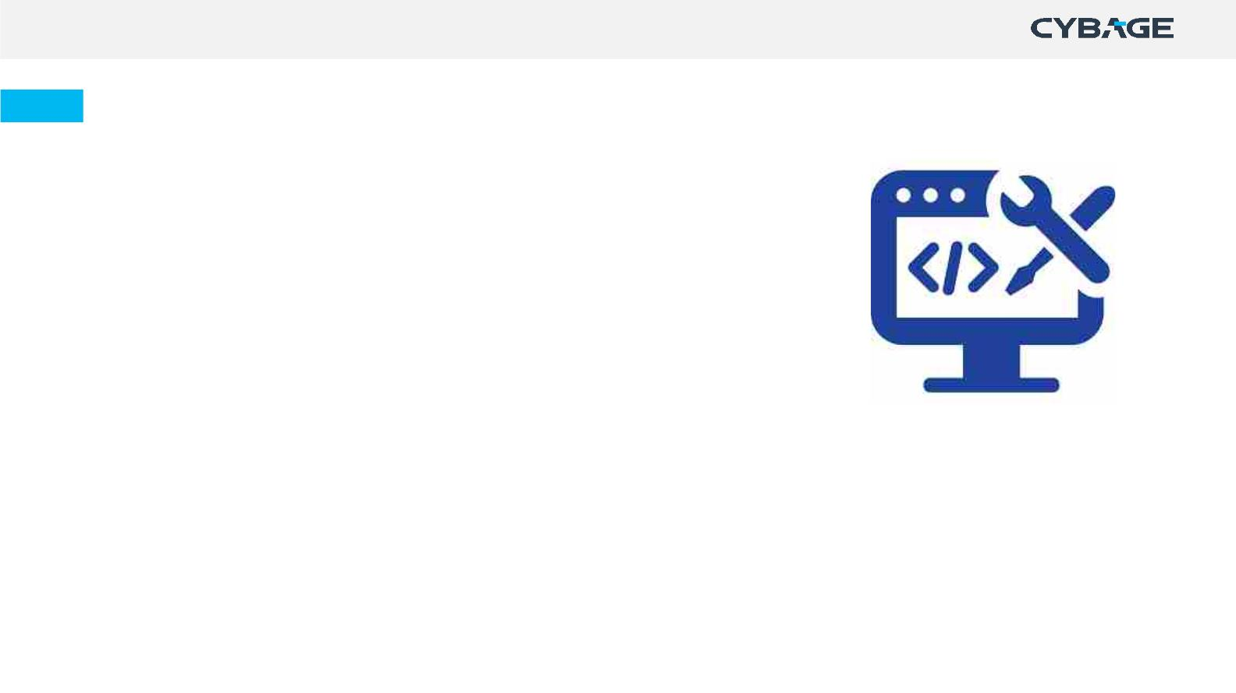
Tool Setup
Ø Know the tools to be used in project
Ø Identify all work item types to be used
Ø Understand the workflow for the work item types
Ø Establish Integration of repository management and CI/CD tools
Ø Know the development/branching strategy (Git flow or Trunk based)
Ø Understand the branch protection rules configured
Ø Understand merge checks applied
Ø Integrate static code analysis tool in CI pipeline to execute it automatically once you merge your code
Ø Identify labels/tag, e.g.: functional, non-functional, CR etc.
Copyright © 2021 Cybage Software Pvt. Ltd. All Rights Reserved. Cybage Confidential.
www.cybage.com
20

Slide 21

Development Practices
Copyright © 2021 Cybage Software Pvt. Ltd. All Rights Reserved. Cybage Confidential.
21

Slide 22
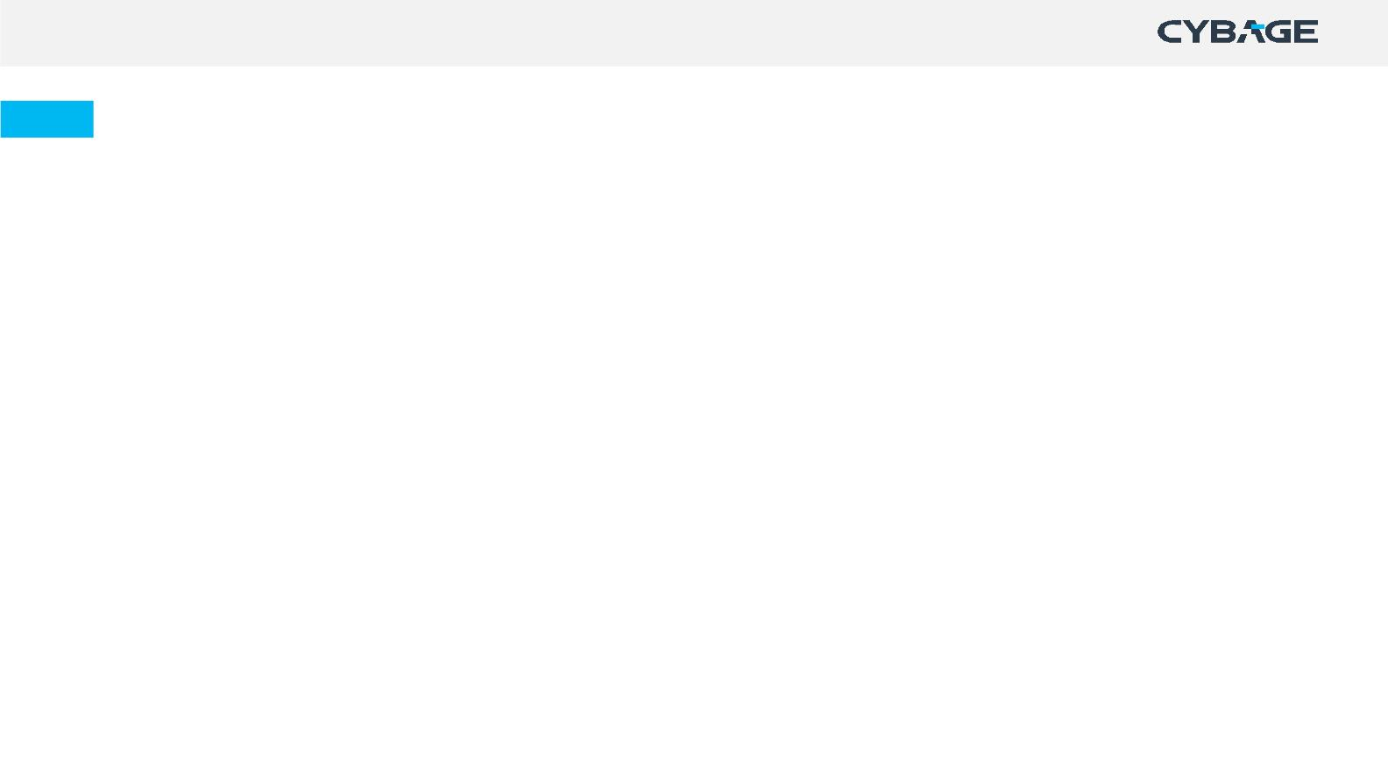
Backlog Refinement
Product Backlog: A product backlog is a list of everything that needs to be achieved on a project, broken down into individual
Ø
Revisit items on the product backlog to make sure that the backlog contains the right items, and they are prioritized
i t e m s ,Ucnadl l e rds tuasnedr sRteoqr iueisr e m e n t s / Features/ Stories
Ø
PØrodHuecltpBp raocdkulcotgowRneefrini nermefiennintg/Ganrdo oprmioirnitigzi:n gA trheec ubr ar icnkgl oegv ei tnetmf os r Agile teams to ensure that the product backlog is
Break larger PBI's up into smaller PBI’s
uØnderstood by team and the right user stories are prioritised for the upcoming sprints.
Ø
Ø
Ø
Ø
Ø
Provide estimation based on type of estimation & techniques used in the project
Discuss & ask queries to product owner with respect to user stories & acceptance criteria
Re-estimate Product Backlog items with respect to the newly discovered information
Update the requirement management tool with the responses.
Participate in the risk analysis of user stories.
For more information on Sprint Refinement, refer Product Backlog Refinement Guideline.
Copyright © 2021 Cybage Software Pvt. Ltd. All Rights Reserved. Cybage Confidential.
www.cybage.com
22

Slide 23
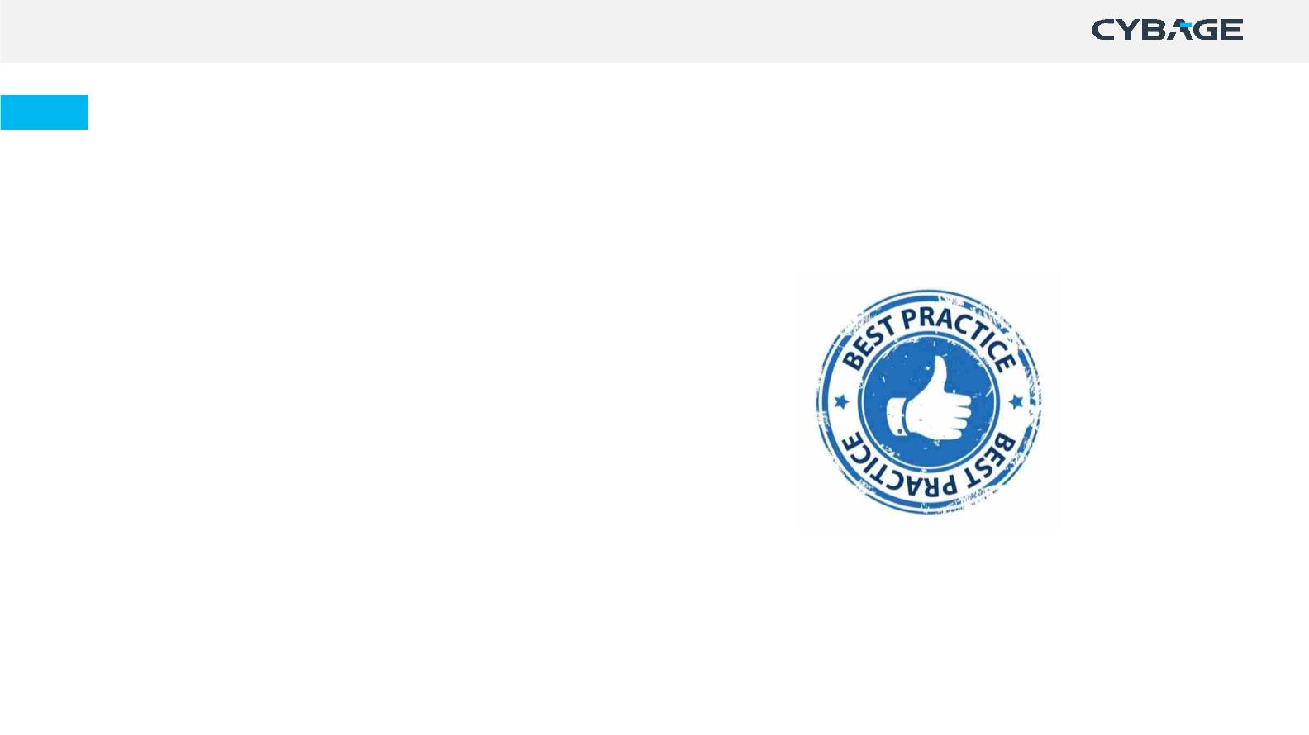
Backlog Refinement – Best Practices
Ø Ensure that the product backlog items are
updated in line with any discussions held or
clarifications made
Ø Keep Definition of Ready handy & use it as a
checklist for backlog refinement
Ø Make it DEEP (Detailed appropriately, Estimated,
Emergent and Prioritized)
Ø Keep clear understanding of dependencies &
constraints.
Copyright © 2021 Cybage Software Pvt. Ltd. All Rights Reserved. Cybage Confidential.
www.cybage.com
23

Slide 24
Sprint Planning
A time-boxed event that occurs at the beginning of a sprint/iteration where the team determines the
product backlog items, they will work on during that sprint.
Ø
Ø
Ø
Ø
Have the individual capacity updated prior to the sprint planning meeting
Participate in sprint planning meeting
Negotiate with the product owner and finalize the Sprint Goal and plan for delivering the increment
Select items from the Product Backlog to include in the current Sprint and refine as required to increase
understanding and confidence
Ø
Ø
Ø
Ø
Ø
Determine how much work you can do realistically to meet the Sprint goal
Breakdown sprint backlog items into tasks
Estimate the tasks and see if the efforts are inline with the story points
Highlight dependencies, risks and impediments (if any)
Self assign the tasks.
For more information on Sprint Planning, refer Sprint Planning Guideline.
Copyright © 2021 Cybage Software Pvt. Ltd. All Rights Reserved. Cybage Confidential.
www.cybage.com
24

Slide 25
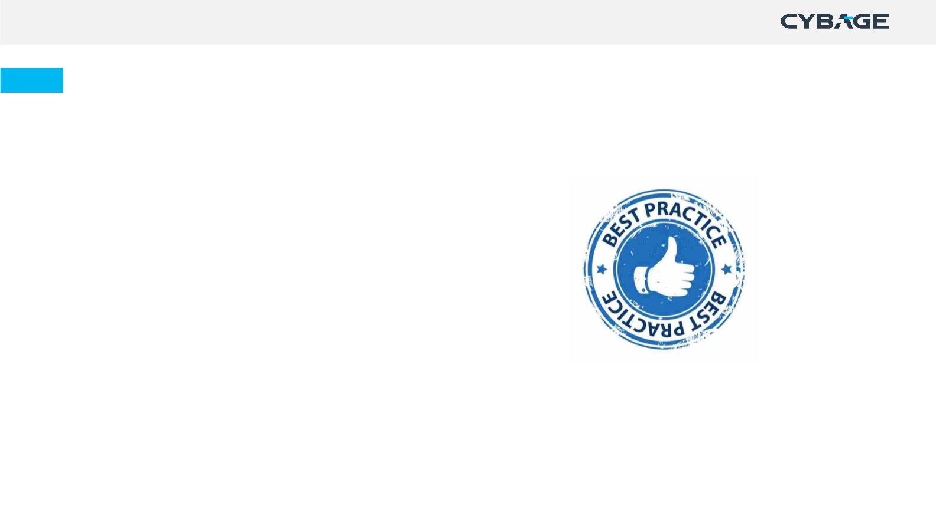
Best Practices - Sprint Planning
Ø Keep the sprint goal in mind
Ø Keep meetings timeboxed
Ø Ask questions to clear any ambiguity
Ø Do not commit more than you can not deliver
Ø Remember to think of your personal availability
for the coming sprint.
Copyright © 2021 Cybage Software Pvt. Ltd. All Rights Reserved. Cybage Confidential.
www.cybage.com
25

Slide 26
Activities in Iteration/Sprint
Designꢀ
Ø Design can be incremental or up-front.
Ø Participate in architectural design creation, if involved
Ø Get the created design artifact(s) reviewed internally and share it with the relevant stakeholders (E.g., Client,
Architect) for their approval.
Ø In case the design artifacts are provided by client, analyze them, and get the queries cleared from the POC.
Note: Up-front design comes even before planning the first sprint.
Copyright © 2021 Cybage Software Pvt. Ltd. All Rights Reserved. Cybage Confidential.
www.cybage.com
26

Slide 27
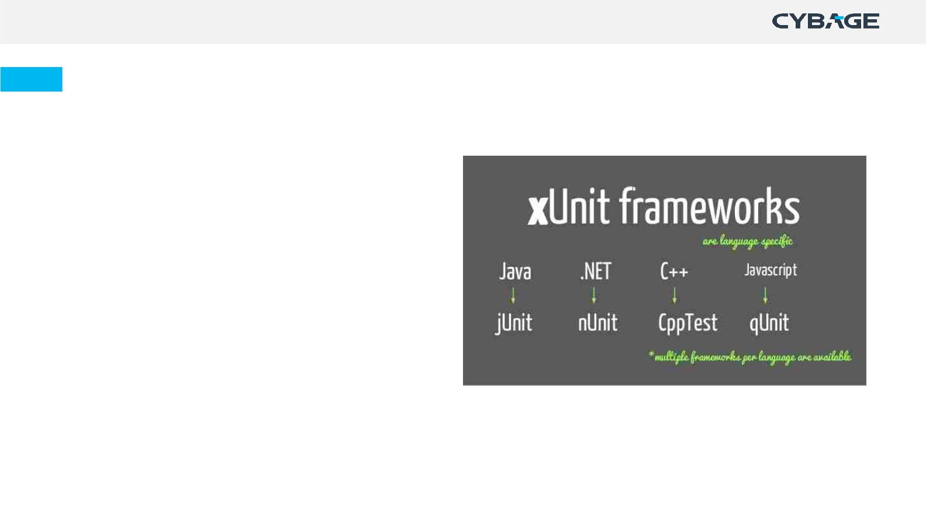
Activities in Iteration/Sprint
Unit Test Creation
Ø Write automated unit test cases (test scripts)
Ø Make use of Unit Testing frameworks like
nUnit, Jasmine, jUnit, PHPUnit
Ø In case of manual unit testing, write unit test
cases and maintain the records
Ø Ensure to update unit tests for changes in
functionality.
Note: In case project does not have QA/Testing in scope, Unit test Scripts/Cases reviews are highly
recommended.
Copyright © 2021 Cybage Software Pvt. Ltd. All Rights Reserved. Cybage Confidential.
www.cybage.com
27

Slide 28
Activities in Iteration/Sprint
Development/Coding
Ø
Ø
Ø
Ø
Ø
Ø
Ø
Ø
Ø
Ø
Ø
Study the design
Clone the remote repository to local (If working for the first time) or pull the repository
Create a branch, as per the branching strategy defined
If working on legacy code, baseline the code quality measures (Running Static Code analysis)
Configure the extension(s) and plugin(s) to IDE (like SonarLint, NUnit, NCrunch etc.).
Construct code as per the Story/Feature Description and defined Acceptance criteria
Follow proper coding standards defined for technology used in project
Perform Static Code Analysis using tools like SonarQube, FxCop, Veracode
Make sure all the quality gates configured, are passed
Fix the bugs identified in static code analysis
Execute the Unit Test Cases/Scripts.
Copyright © 2021 Cybage Software Pvt. Ltd. All Rights Reserved. Cybage Confidential.
www.cybage.com
28

Slide 29
Activities in Iteration/Sprint
Development/Coding
Ø
Ø
Commit code with appropriate commit message E.g., User story ID, limit the message to 50 characters.
Tag the commits before pushing
ü
Recommend creating annotated commit tags if required to maintain the information/ history E.g.: git tag -a v1.0 -m “My Version
1.0”
Ø
Ø
Ø
Ø
Ø
Ø
Ø
Ø
Create a pull request in repository management tool for the code committed to be reviewed
Perform code review (as per the required {#} reviewers) and provide the review comments
Incorporate the review comments provided by the reviewer in the tool
Verify if the review comments are incorporated and approve the pull request
Fork a repository while experimenting or helping with other people’s work
Perform Static Code Analysis to get the code coverage (as per identified threshold)
Merge the code with the designated branch
Fix the bugs reported by QA Team.
Copyright © 2021 Cybage Software Pvt. Ltd. All Rights Reserved. Cybage Confidential.
www.cybage.com
29

Slide 30
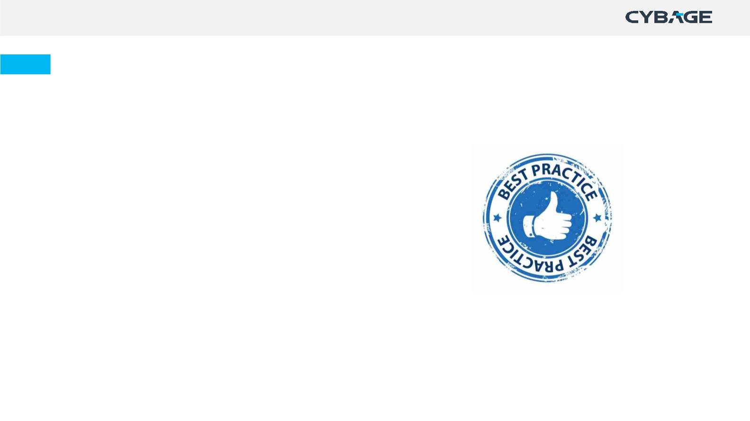
Best Practices - Development
Ø Follow branch naming convention rules, use User
Story ID.
Ø Perform one round of internal code review before
customer review
Ø At least 2 reviewers should review and approve the
code, before merging
Ø Label the PRs for easy categorization
Ø Avoid giving verbal review comments.
Copyright © 2021 Cybage Software Pvt. Ltd. All Rights Reserved. Cybage Confidential.
www.cybage.com
30

Slide 31
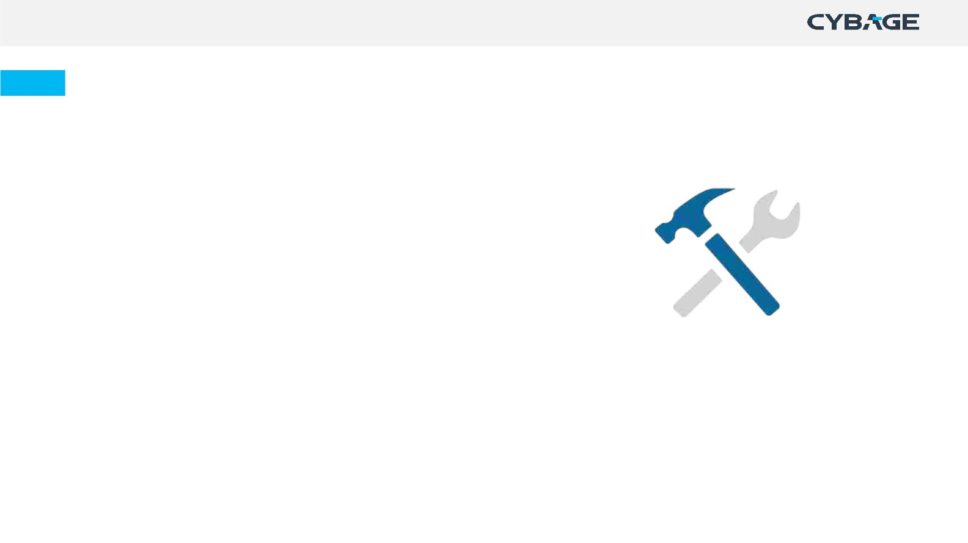
Activities in Iteration/Sprint
Build (Continuous Integration)
Ø
Ø
Create build definition.
Set up the CI pipeline.
Possible steps may include the following but, not limited to:
ü
ü
ü
ü
ü
Artifact Management (E.g.: JFrog Artifactory, Nexus, etc.)
Source Code Management (E.g.: GitHub, Bitbucket, etc.)
Unit Test Scripts
Static Code Analysis
QA Test scripts (E.g.: Smoke, Integration, Regression, etc.)
Notification configuration (E.g.: Email, IM, etc.)
ü
Ø
Build
If the job status is ‘SUCCESS’/ ‘PASS’/ any other label convention, a package is created.
A notification is sent to the repository manager to store the binaries produced, the package, build information, dependencies and
unit test results (E.g.: Jenkins on Job status as ‘success’, creates a package and notifies JFrog using plug-in to store it along with its
meta-data).
Note: Creating build definition may vary upon tool to tool.
Copyright © 2021 Cybage Software Pvt. Ltd. All Rights Reserved. Cybage Confidential.
www.cybage.com
31

Slide 32
Activities in Iteration/Sprint
Build (Manual)
Ø Send a notification to Build Engineer to inform about
code freeze
Ø Generate the Build ID/ version.
Ø Get the latest checked in Source code and compile it.
Ø Create the Build by taking code from the latest version.
Ø Create Read Me and Release Notes
Ø Communicate build details to relevant stakeholders
(QA/Client).
Copyright © 2021 Cybage Software Pvt. Ltd. All Rights Reserved. Cybage Confidential.
www.cybage.com
32

Slide 33
General Activities - Iteration/Sprint
Ø Participate in daily scrum meeting and discuss the progress towards meeting the sprint goal
Ø Keep updating the status in tools
Ø Log efforts on daily basis
Ø Collaborate with team members (for help required, task dependencies)
Ø Highlight real time queries to appropriate stakeholders and get them resolved
Ø Highlight dependencies
Ø Identify measures for yourself and monitor them. Ex: Issues, Quality, Lines of Code
Ø Make dashboard for yourself for self tracking.
Copyright © 2021 Cybage Software Pvt. Ltd. All Rights Reserved. Cybage Confidential.
www.cybage.com
33

Slide 34
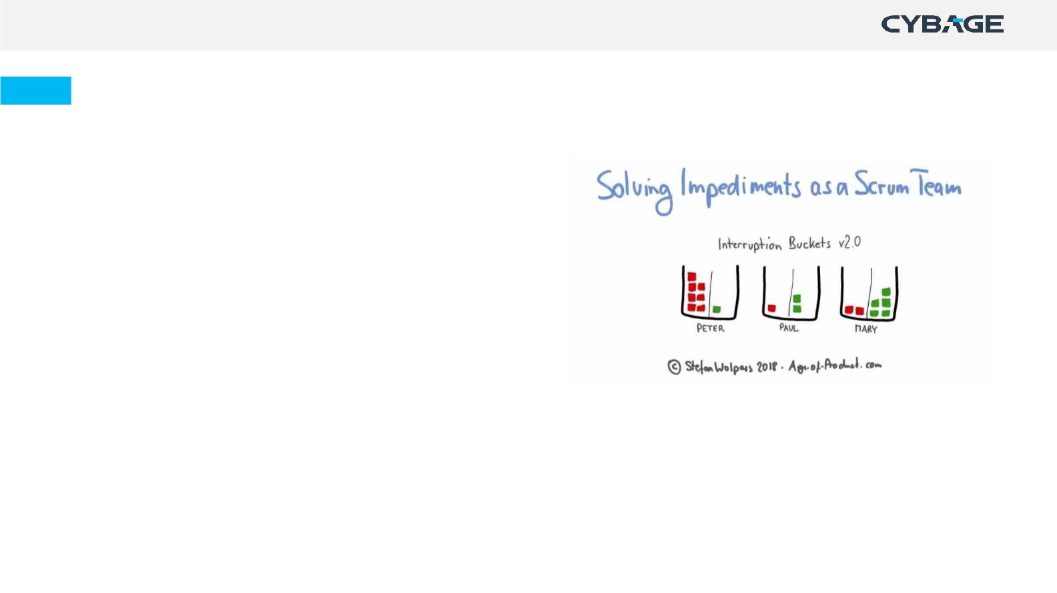
Tactics for Removing Impediments
Ø Do not wait until the Daily Scrum to raise an
impediment!
Ø Use a sprint goal to decide if something is truly an
impediment
Ø Improve transparency by using an 'Impediment Board’
Ø Keep track of fixed impediments
Ø Be brave and creative in removing impediments
Ø Help other teammates with their impediments.
Examples: Illness of team members, Lots of technical debt, Unavailability of the Product Owner
Copyright © 2021 Cybage Software Pvt. Ltd. All Rights Reserved. Cybage Confidential.
www.cybage.com
34

Slide 35
Best Practices - Iteration/Sprint
Ø Attach all the supporting artifacts with the User
Story in tool
Ø Perform code refactoring
Ø Performing branch clean up activity
Ø Conduct Knowledge sharing sessions frequently
(weekly/ fortnightly basis)
Ø Keep an eye on Information Radiators of the
project E.g., Burn up / Down chart, Velocity Trend,
etc.
Copyright © 2021 Cybage Software Pvt. Ltd. All Rights Reserved. Cybage Confidential.
www.cybage.com
35

Slide 36
Sprint Review/Demo
Sprint review is an activity at the end of the Sprint where the increment is presented to Product Owner,
relevant stakeholders invited by PO to obtain their feedback on the developed product.
Ø Participate in Sprint Review meeting.
Ø 'Inspect' the increment and 'Adapt' the product backlog
Ø Demonstrateꢀthe work that has been “Done” and answer the questions about the Increment
Ø Note down the action items if any review comments are there
Ø Discuss what to do next (to subsequentꢀSprint).
For more information on Sprint Review, refer Sprint Review Guideline.
Copyright © 2021 Cybage Software Pvt. Ltd. All Rights Reserved. Cybage Confidential.
www.cybage.com
36

Slide 37

Best Practices - Sprint Review/Demo
Ø Make sure to have event timeboxed
Ø Treat all feedback as welcome feedback, especially
from stakeholders
Ø Ask for suggestions from everyone (including
developers) on how to gain more value from the
current and future features
Ø Inspect sprint deliverable & adapt product backlog.
Copyright © 2021 Cybage Software Pvt. Ltd. All Rights Reserved. Cybage Confidential.
www.cybage.com
37

Slide 38

Sprint Retrospective
The Retrospective is a time-boxed event in agile providing an opportunity to the team to inspect itself and
Ø Participate in retrospective meeting
create a plan for improvements to be enacted during the next iteration.
Ø Discuss What went well in the Sprint, What impediments were there
Ø Revisit actions from previously conducted retrospective
Ø Commit on what to improve in the next Sprint
Ø Make sure every issue or idea is clear to all team members
Ø Techniques to perform Retrospective
ü Start, Stop, Continue
ü Mad, Sad & Glad
ü 4 Ls (Liked, Learned, Lacked, Longed for)
ü KALM (Keep, Add, Less, More) etc.
Tools: TeamRetro, Ideaboardz, Confluence, FunRetro etc.
For more information on Sprint Retrospective, refer Sprint Retrospective Guideline.
Copyright © 2021 Cybage Software Pvt. Ltd. All Rights Reserved. Cybage Confidential.
www.cybage.com
38

Slide 39
Best Practices - Sprint Retrospective
Ø Provide honest feedback
Ø Follow clear boundaries for the conversation
Ø Define the time period and discussion points, and
focus on improvements
Ø Criticize Work, Not People
Ø Own the meeting and take responsibility for the
decisions you made.
Copyright © 2021 Cybage Software Pvt. Ltd. All Rights Reserved. Cybage Confidential.
www.cybage.com
39

Slide 40
Deployment
Continuous Deployment, is the Continuous Delivery pipeline without any manual gates/ manual intervention
like: Manual testing, Code Reviews, Demo to Product Owner and/or stakeholders.
E.g.: A pipeline with stages ‘code check-in’ -> ‘automated compilation’ -> ‘build’ -> ‘unit tests’ -> ‘Automated
test scripts’ -> ‘deployment to production’.
If deployment is successful
Ø Replicate the stable build to other environment servers – as per the deployment strategy.
Ø Notification is sent to required stakeholders on successful roll-out.
Ø Monitor application performance metrics configured to keep a check on critical Infrastructure components.
Ø Make use of tools for Infrastructure Monitoring (E.g.: Nagios, Splunk, etc.)
Copyright © 2021 Cybage Software Pvt. Ltd. All Rights Reserved. Cybage Confidential.
www.cybage.com
40

Slide 41
Deployment
If deployment is unsuccessful
Ø Implement roll back steps as per the plan defined in deployment strategy for rollback
Ø Document the scenario specific roll back procedures
Ø Verify if the roll back is successful
Ø Log the defect
Ø Fix the issue
Ø Roll out the repaired build to Production - environment
Ø Verify if the build is stable.
Copyright © 2021 Cybage Software Pvt. Ltd. All Rights Reserved. Cybage Confidential.
www.cybage.com
41

Slide 42
Deployment
Manual deployment
Ø
Ø
Take the backup of the production/working environment
Install the build and execute deployment test cases.
In case of deployment issues:
Ø
Ø
Ø
Ø
Ø
Ø
Notify stakeholders.
Log the deployment defect in the defect tracking tool and apply label to it (Label of production issue)
Install the previous stable state & execute Roll-back test cases
Verify Roll-back, if successful
Notify stakeholders about the successful Roll-out
Conduct RCA of the issues.
Copyright © 2021 Cybage Software Pvt. Ltd. All Rights Reserved. Cybage Confidential.
www.cybage.com
42

Slide 43
Deployment
Post deployment issues
Ø Verify the defects identified, post-deployment
Ø Log the defect in the defect tracking tool, if required
Ø Perform the fixes (can be a patch) or rebuild as per the build steps
Ø Execute the deployment test cases, if required
Ø Notify the relevant stakeholders about the fix
Ø Conduct Postmortem / Root Cause Analysis of Post Deployment issues.
Copyright © 2021 Cybage Software Pvt. Ltd. All Rights Reserved. Cybage Confidential.
www.cybage.com
43

Slide 44

Complement to Project Management
Copyright © 2021 Cybage Software Pvt. Ltd. All Rights Reserved. Cybage Confidential.
www.cybage.com
44

Slide 45
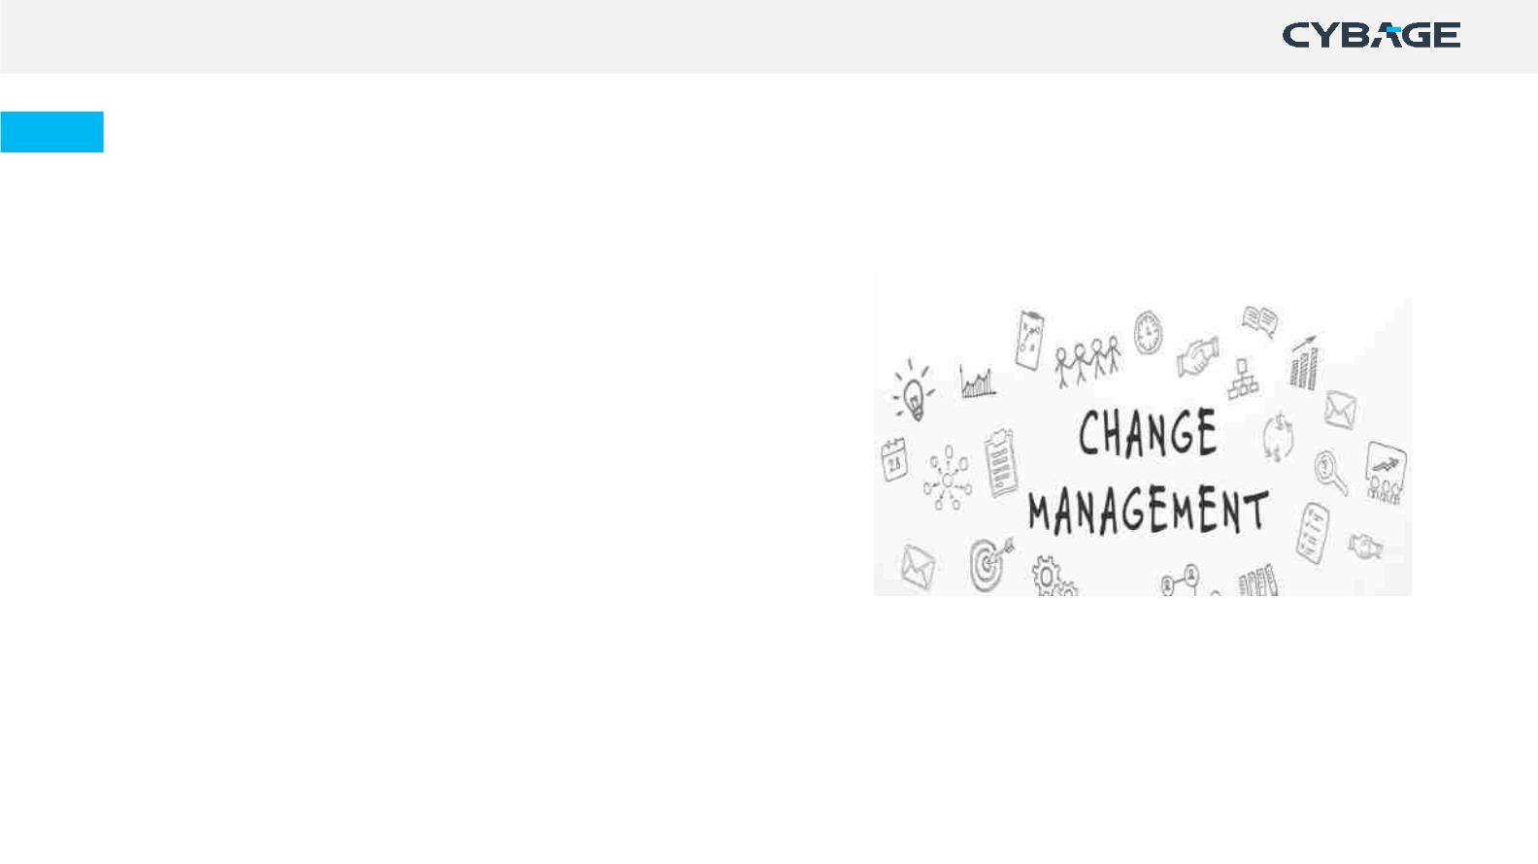
Change Management
Ø
Ø
Ø
If any change request is received, discuss with lead
Participate in impact analysis and feasibility study, if involved
Log those in requirement management tools such as JIRA,
Azure
Ø
Ø
Ø
Add appropriate labels to segregate these, helps in tracking!
Implement the change(impacted modules/files)
Update the status and communicate the change status to
relevant stakeholders.
Note: Change Management process is specific to a waterfall projects. It is not applicable in Agile projects.
Copyright © 2021 Cybage Software Pvt. Ltd. All Rights Reserved. Cybage Confidential.
www.cybage.com
45

Slide 46
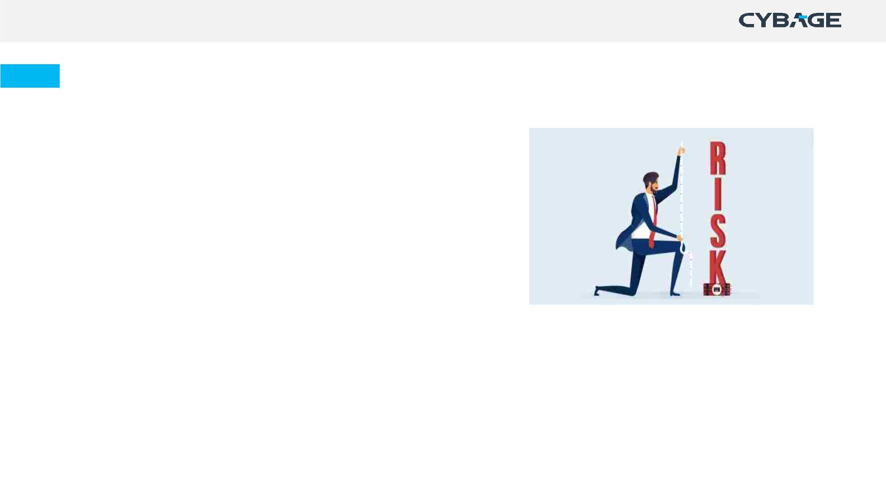
Risk Management
Risk is any potential threat which can affect the project.
Ø Identify the possibility of technical risks occurring
Ø Identify the impact of risk
Ø Share the risk with PM, SM/PO & Team members as required
Ø Provide inputs to reduce risk impact.
Copyright © 2021 Cybage Software Pvt. Ltd. All Rights Reserved. Cybage Confidential.
www.cybage.com
46

Slide 47
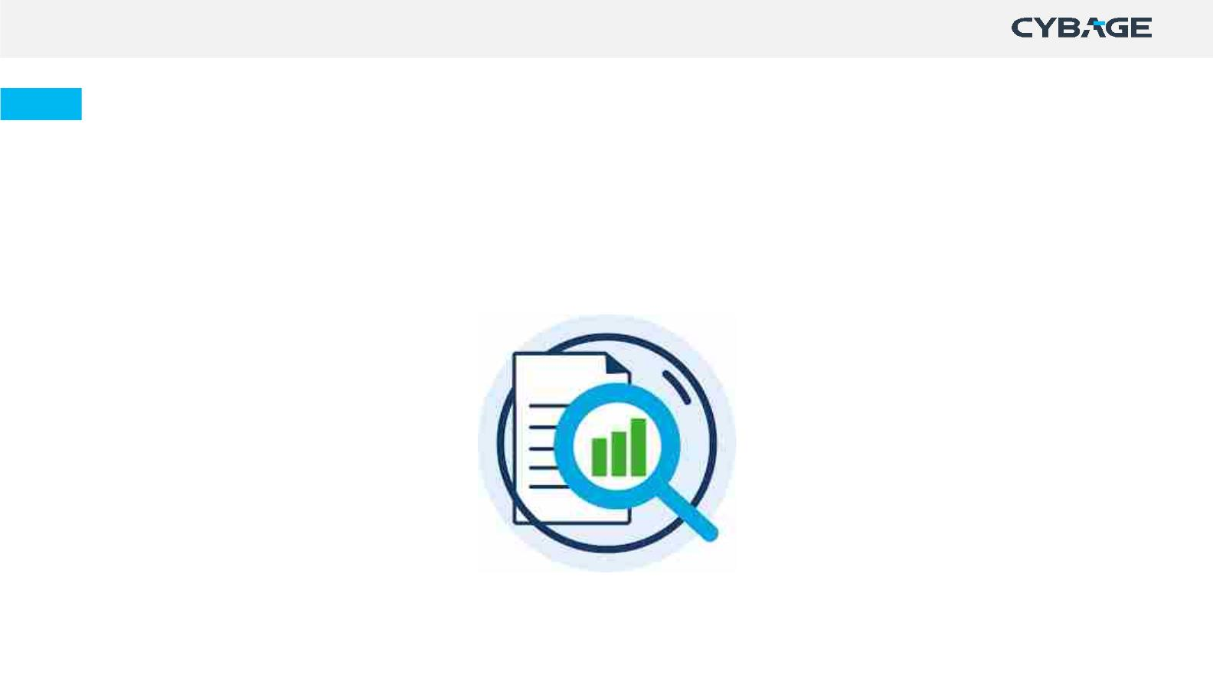
Root Cause Analysis (RCA) & Decision Analysis
Ø Participate in collecting and analysing the data for analysis.
Ø Participate in RCA, Decision analysis
Ø Perform the necessary actions identified.
Root Cause Analysis techniques
Decision Analysis techniques
ü 5 Why Analysis
ü Pareto Analysis
ü Fishbone Analysis
ü Decision Matrix Analysis
ü Forced field Analysis
ü Brainstorming
Copyright © 2021 Cybage Software Pvt. Ltd. All Rights Reserved. Cybage Confidential.
www.cybage.com
47

Slide 48

Root Cause Analysis Techniques
Please click on the video
Copyright © 2021 Cybage Software Pvt. Ltd. All Rights Reserved. Cybage Confidential.
www.cybage.com
48

Slide 49

Other Areas to contribute - Project Management
Ø Estimations
Ø Client Call Summary and Action items
Ø Timely and concise status reports (if required)
Ø Leave Calendars
Ø Suggest improvements.
Copyright © 2021 Cybage Software Pvt. Ltd. All Rights Reserved. Cybage Confidential.
www.cybage.com
49

Slide 50
Contribute Horizontally!
Copyright © 2021 Cybage Software Pvt. Ltd. All Rights Reserved. Cybage Confidential.
www.cybage.com
50

Slide 51
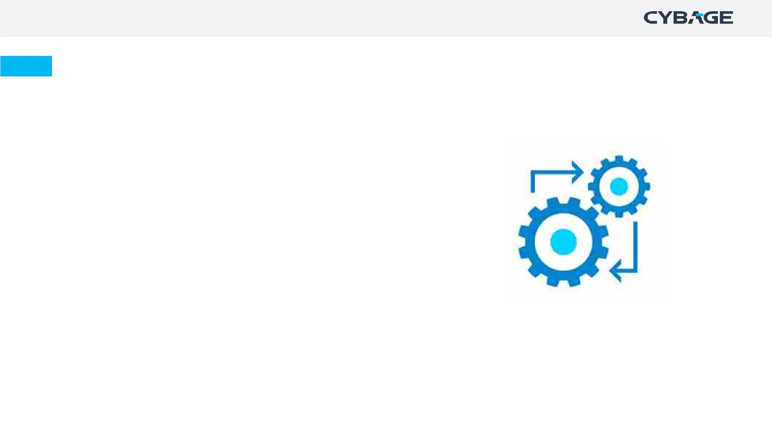
Configuration Management
Systematically controlling changes to the Configurable Items (CIs), maintaining the integrity and the traceability
of CIs throughout the lifecycle.
Ø
Ø
Ø
Ø
Ø
Follow proper folder structure while creating a folder
Refer naming convention guidelines while creating an artifact
Write proper revision/update message while updating an artifact
Ensure that the latest version of artifacts are available for the entire team
Verify the required access rights to folders and artifacts
Configuration Management Tools: Confluence, Wiki, SharePoint, Git, Bitbucket, CVS etc.
Copyright © 2021 Cybage Software Pvt. Ltd. All Rights Reserved. Cybage Confidential.
www.cybage.com
51

Slide 52
Configuration Management - For Developers
Ø
Ø
Ø
Appropriate Branching
File naming & Code commits with appropriate Commit messages
Label the Pull Requests for categorization, if required (E.g.: In GitHub, labeling a PR as ‘duplicate’ indicates a similar pull
request)
Ø
Ø
Perform Build versioning as per the Build Versioning Guidelines
Set the retention policy for the Build to be created, as required (E.g.: In Azure DevOps, the build to be retained for 60 days
before deleting it).
Ø
Ø
Ø
Configure the drop folder for the Build to be published once created.
In case of rollback to a previous commit, refer the history of commits, and revert the previous stable commit
Clean up the unnecessary/ old/ hanging branches once the code is merged.
For more details, Refer Configuration Management Guideline and Git Best Practices & Guideline.
Copyright © 2021 Cybage Software Pvt. Ltd. All Rights Reserved. Cybage Confidential.
www.cybage.com
52

Slide 53
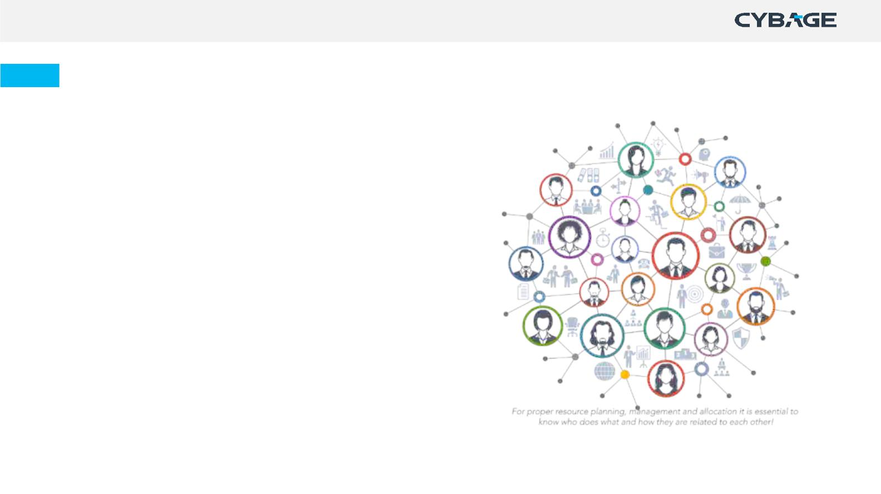
Resource Management
Ø Participate in Product training, knowledge transfer
by the customer during onboarding/execution of
project
Ø Ask for Ramp-up, if joined as new member in
project
Ø Participate in Ramp-up of new team members
Ø Participate in the handover and takeover activity
(if there is resource replacement).
Copyright © 2021 Cybage Software Pvt. Ltd. All Rights Reserved. Cybage Confidential.
www.cybage.com
53

Slide 54

Knowledge Management
The purpose is to gain knowledge, share perspectives,
ideas, experience, knowledge, and information and to
improve efficiency by reducing the need to rediscover
knowledge.
Ø
Ø
Ø
Ø
Self-learning: Perform self-learning, and document the
learnings
Shadow Hierarchy identified within project Team: Record
/Store the Knowledge Management
Trainings: Identify technical areas where you might need
assistance or trainings
Knowledge Sessions: Conduct/attend knowledge.
Copyright © 2021 Cybage Software Pvt. Ltd. All Rights Reserved. Cybage Confidential.
www.cybage.com
54

Slide 55
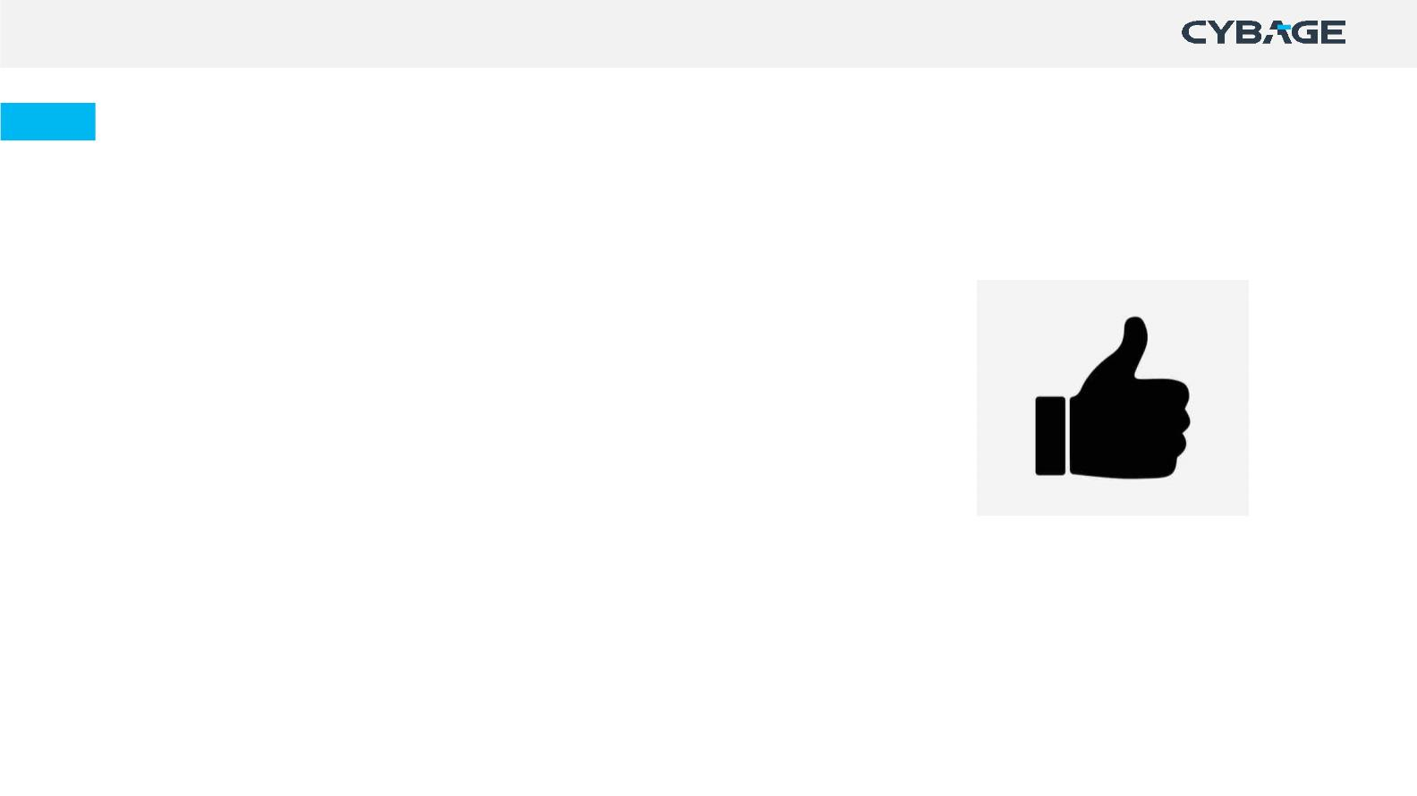
Do’s:
Ø Actively participate in all scrum ceremonies
Ø Keep the sprint goal in mind
Ø Conform to the Definition of Done
Ø Work log regularly
Ø Update the project management and requirement
management tool daily
Ø Attach all artifacts with the User Story in tool
Ø Add appropriate comments in tool
Ø Seek help and provide help as and when needed
Ø Collaborate with the scrum team.
Copyright © 2021 Cybage Software Pvt. Ltd. All Rights Reserved. Cybage Confidential.
www.cybage.com
55

Slide 56
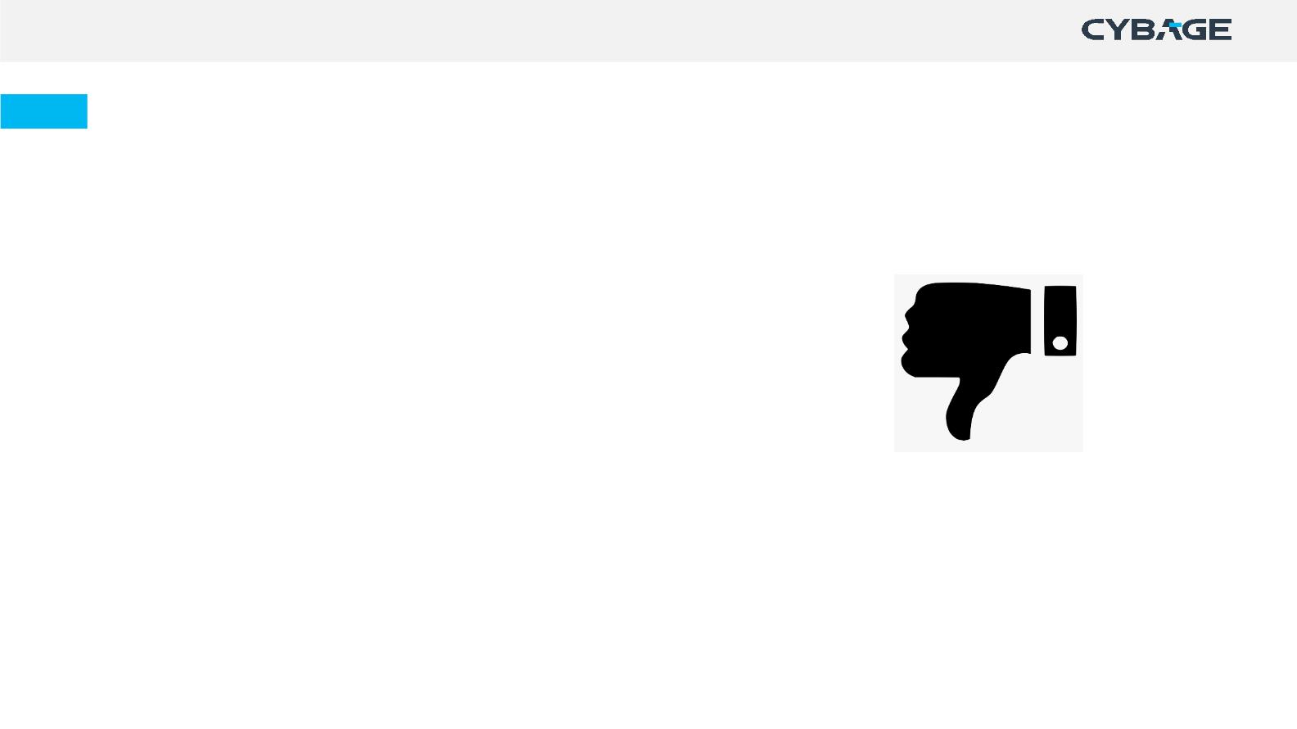
Don’ts:
Ø Wait till the sprint end to update tool
Ø Try to over commit or accommodate last unprioritized
items within the sprint
Ø Perform verbal reviews
Ø Formulate story points into efforts
Ø Try to fix all defects in the same sprint, Defects should
be prioritized
Ø Let the daily scrum become a technical discussion or a
planning meeting.
Copyright © 2021 Cybage Software Pvt. Ltd. All Rights Reserved. Cybage Confidential.
www.cybage.com
56

Slide 57

Thank You!
Copyright © 2021 Cybage Software Pvt. Ltd. All Rights Reserved. Cybage Confidential.
www.cybage.com

